Slide 1

Part III Category learning with a pLoT
Fausto Carcassi

Slide 2
Summary so far
pLoT as a picture of cognition
Some formal tools:
Probabilistic PCFG
Compositional interpretation
Bayesian inference
Part I | Introduction: On the very idea of an LoT
Part II | Technical background
Part III | Bayesian program induction (LOTlib3)
Part IV | Case studies
Part V | Summary & Future prospects

Slide 3
Plan for session
We’ll consider some examples
Combine the technical tools
Build up to a pLoT category learning simulation
Part I | Introduction: On the very idea of an LoT
Part II | Technical background
Part III | Bayesian program induction (LOTlib3)
Part IV | Case studies
Part V | Summary & Future prospects

Slide 4
Our grand plan for the pLoT
Today
pLoT (PCFG)
Bayesian update
data
Linking assumptions
P(data | h)
behaviour
P(h | data)
P(h)

Slide 5
Example 1: The visual domain

Slide 6
Shape grammar
What could we mean by shape grammar?
What would you include in a shape grammar?

Slide 7
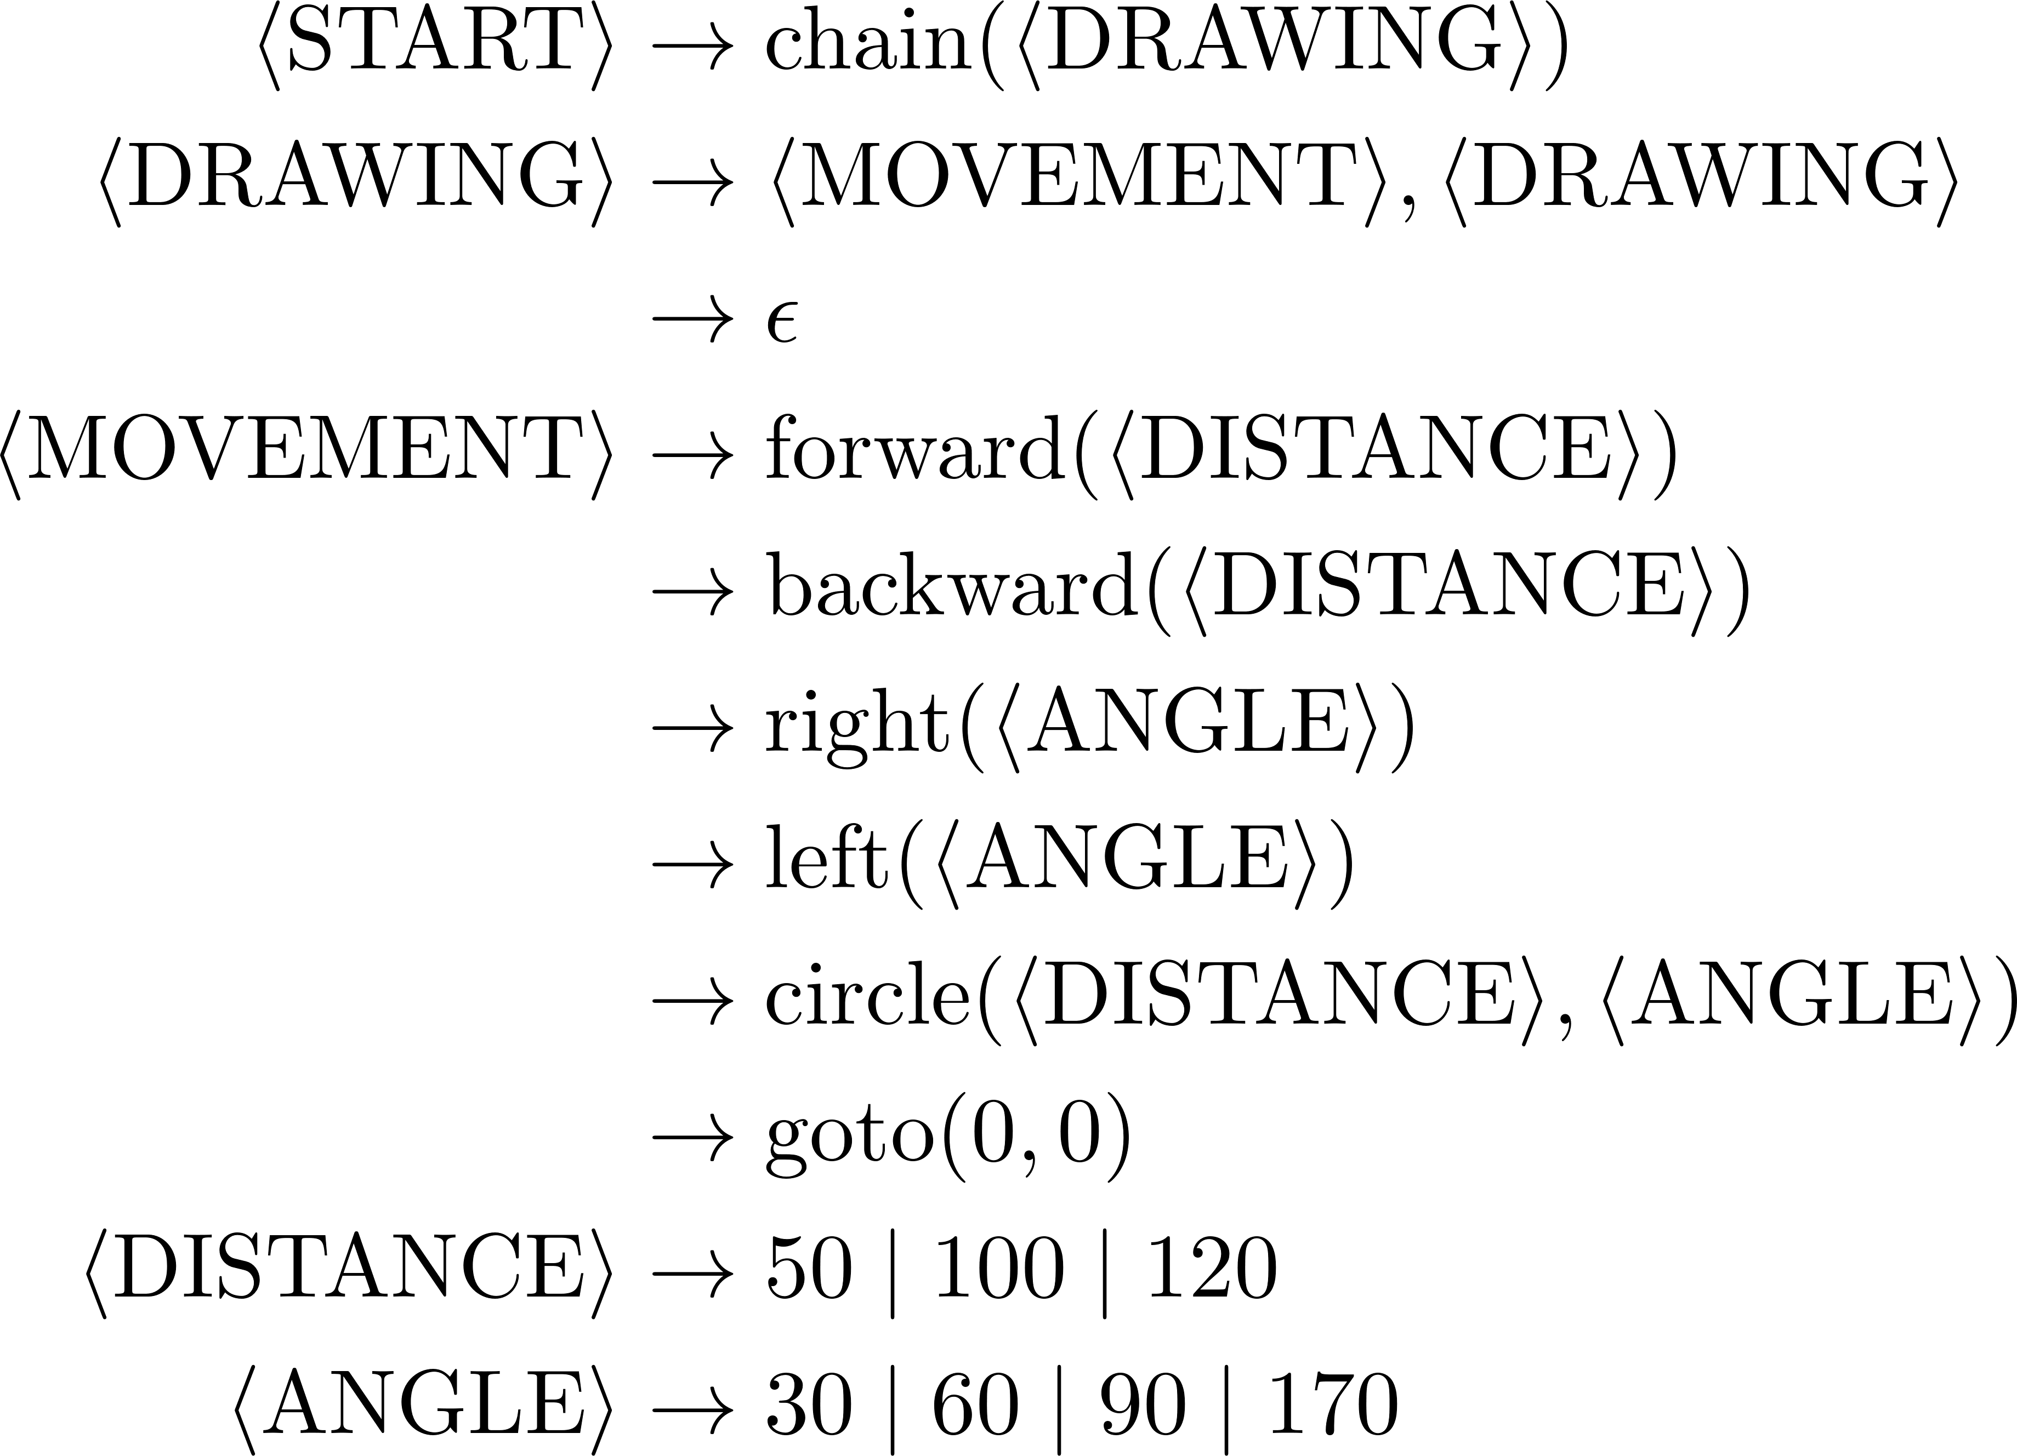
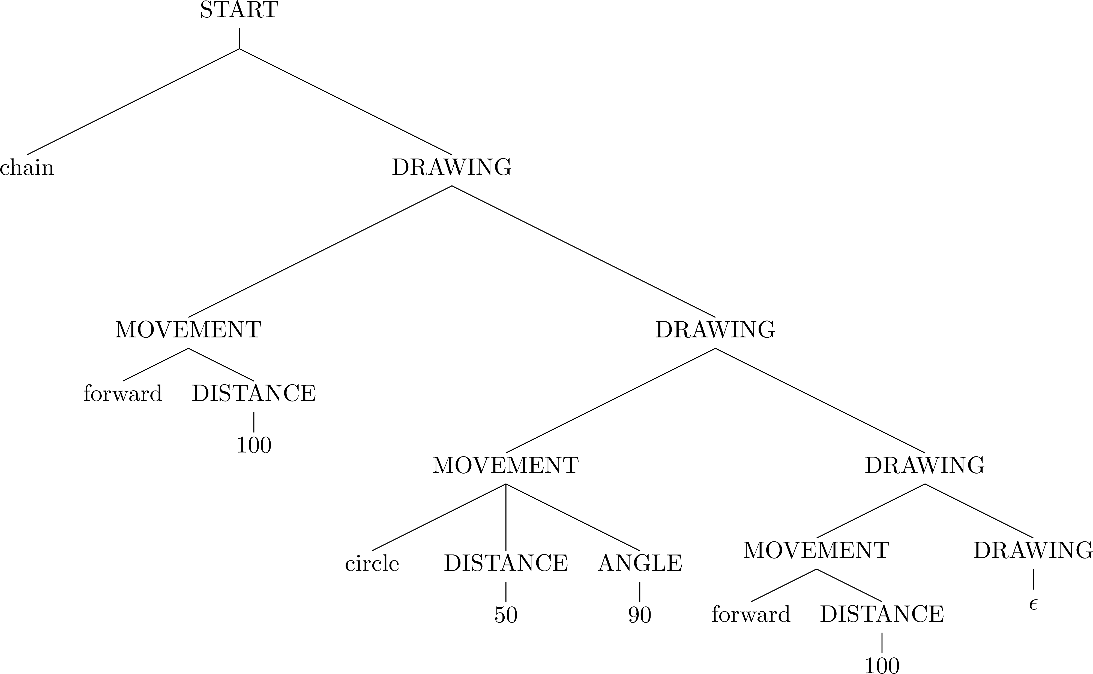
Shape grammar

Slide 8
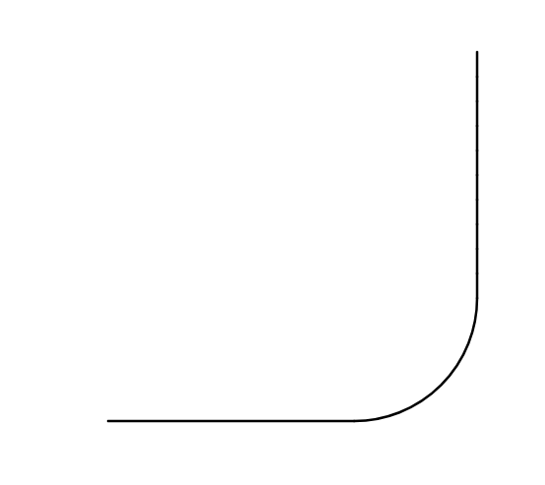
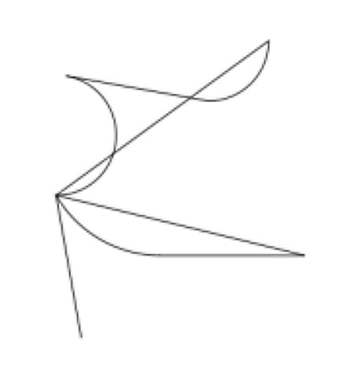
Shape semantics

Slide 9
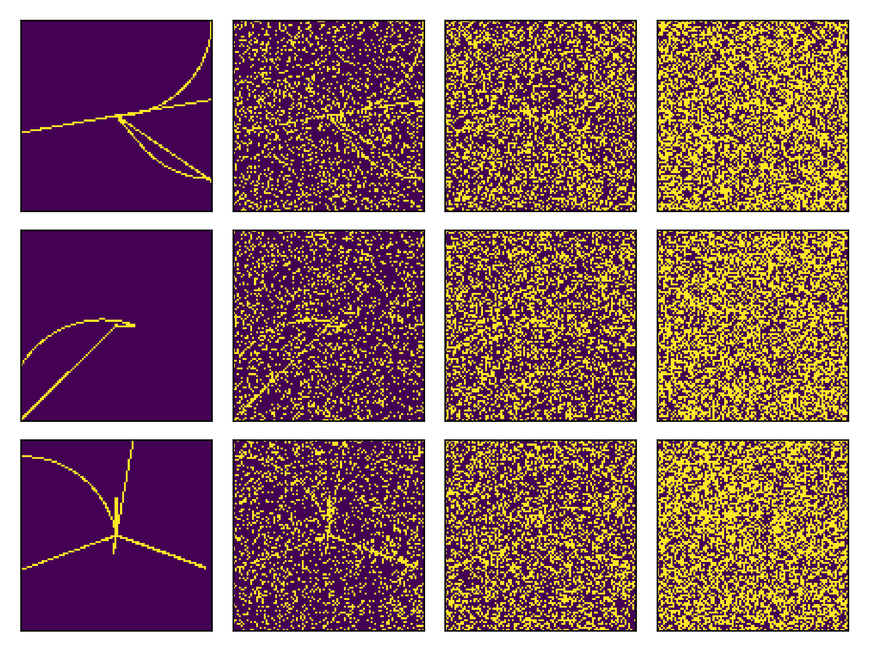
Shape observations
Noise:
Random pixel flip (salt & pepper)
W/ probability p
Can we write a likelihood?

Slide 10
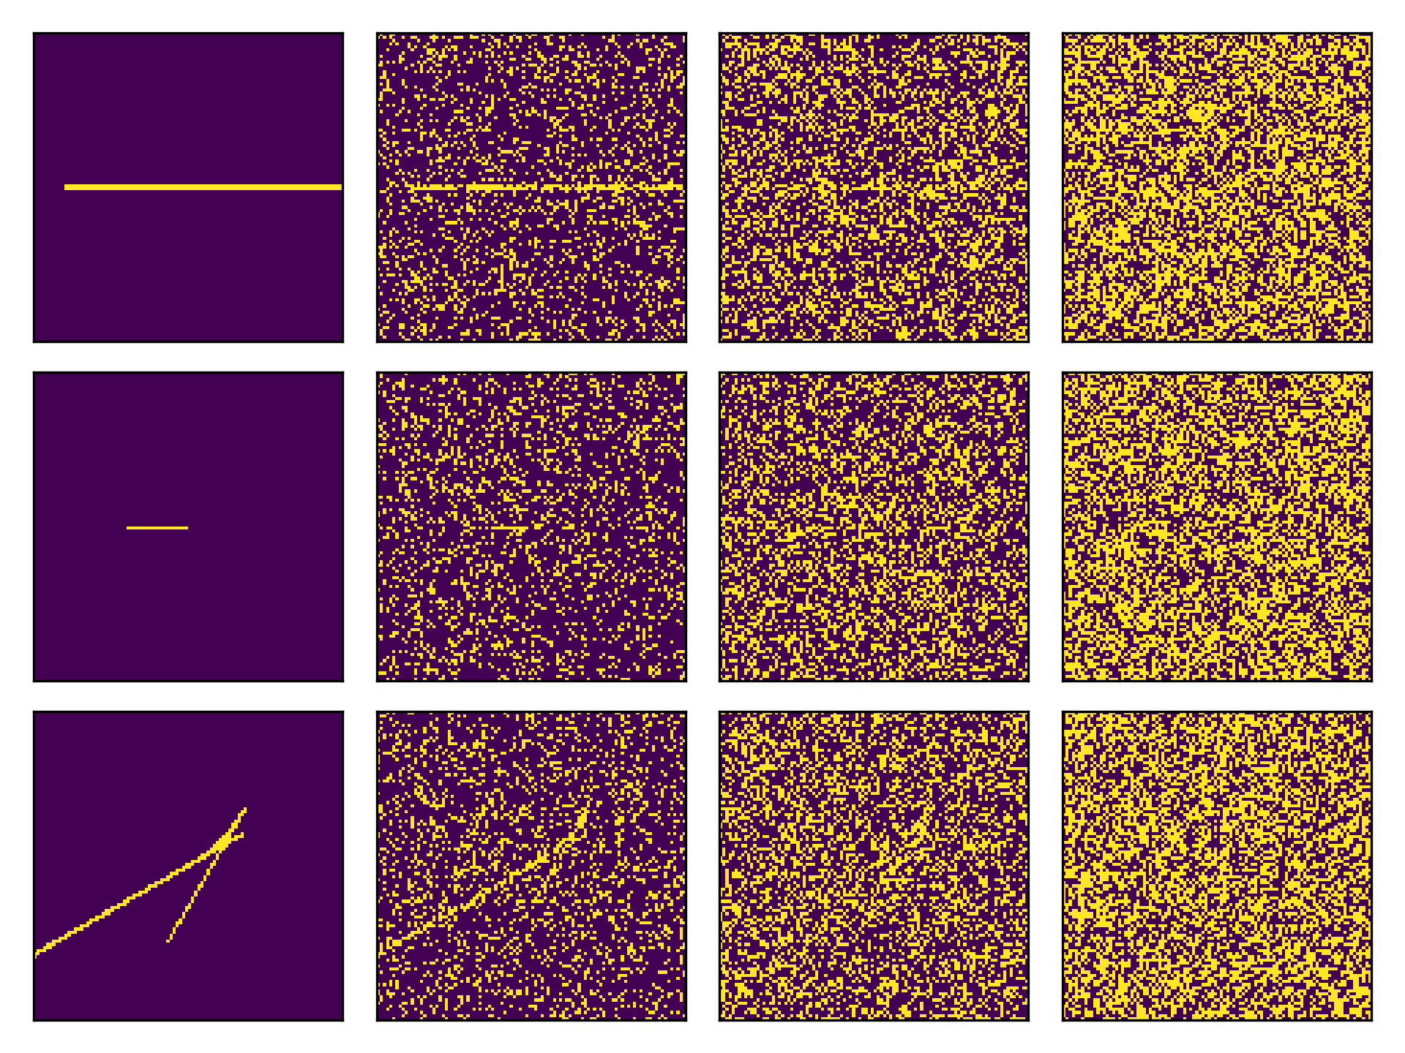


Priors and likelihoods
Observations
Noise level 1
Noise level 2
Noise level 3

Slide 11
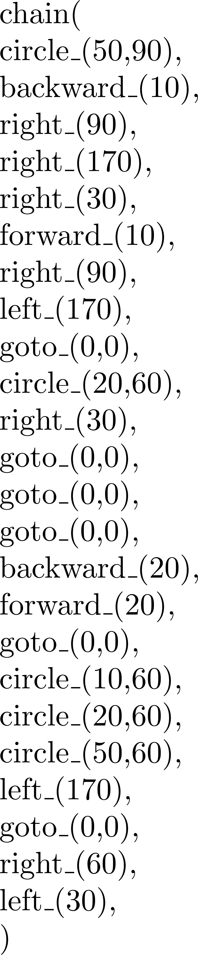
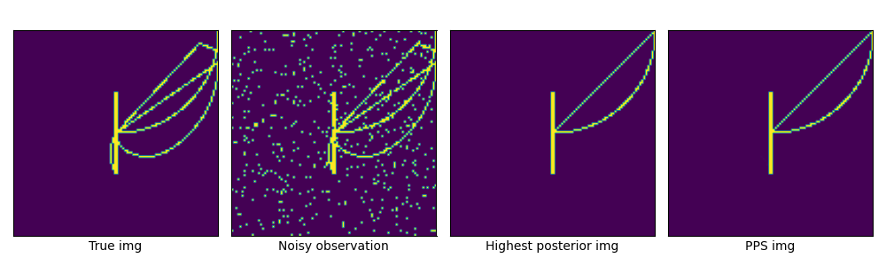
Bayesian inference in the shape grammar
True shape
Noisy observation
Higher posterior shape
Posterior mean

Slide 12
LoT learning models: the big picture
Interpreted PCFG
Defines hypotheses H
Defines a prior over H
Observations O
Generated by true H
Likelihood P(O | H)
Bayesian inference algorithm
Approximate!
Shapes grammar
Each H is a sentence…
…which encodes a shape
Image (with noise)
Multiple H produce same shape!
Likelihood P(image| shape)
MCMC w/ e.g., LOTlib3
Gives us samples from posterior!

Slide 13
Example 2: The auditory domain

Slide 14
Sound grammar
What could we mean by sound grammar?
What would you include in a sound grammar?

Slide 15
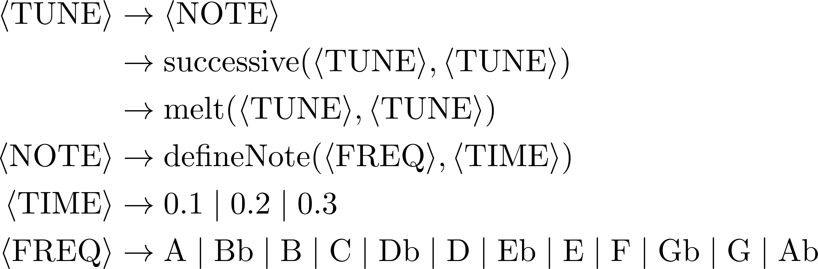
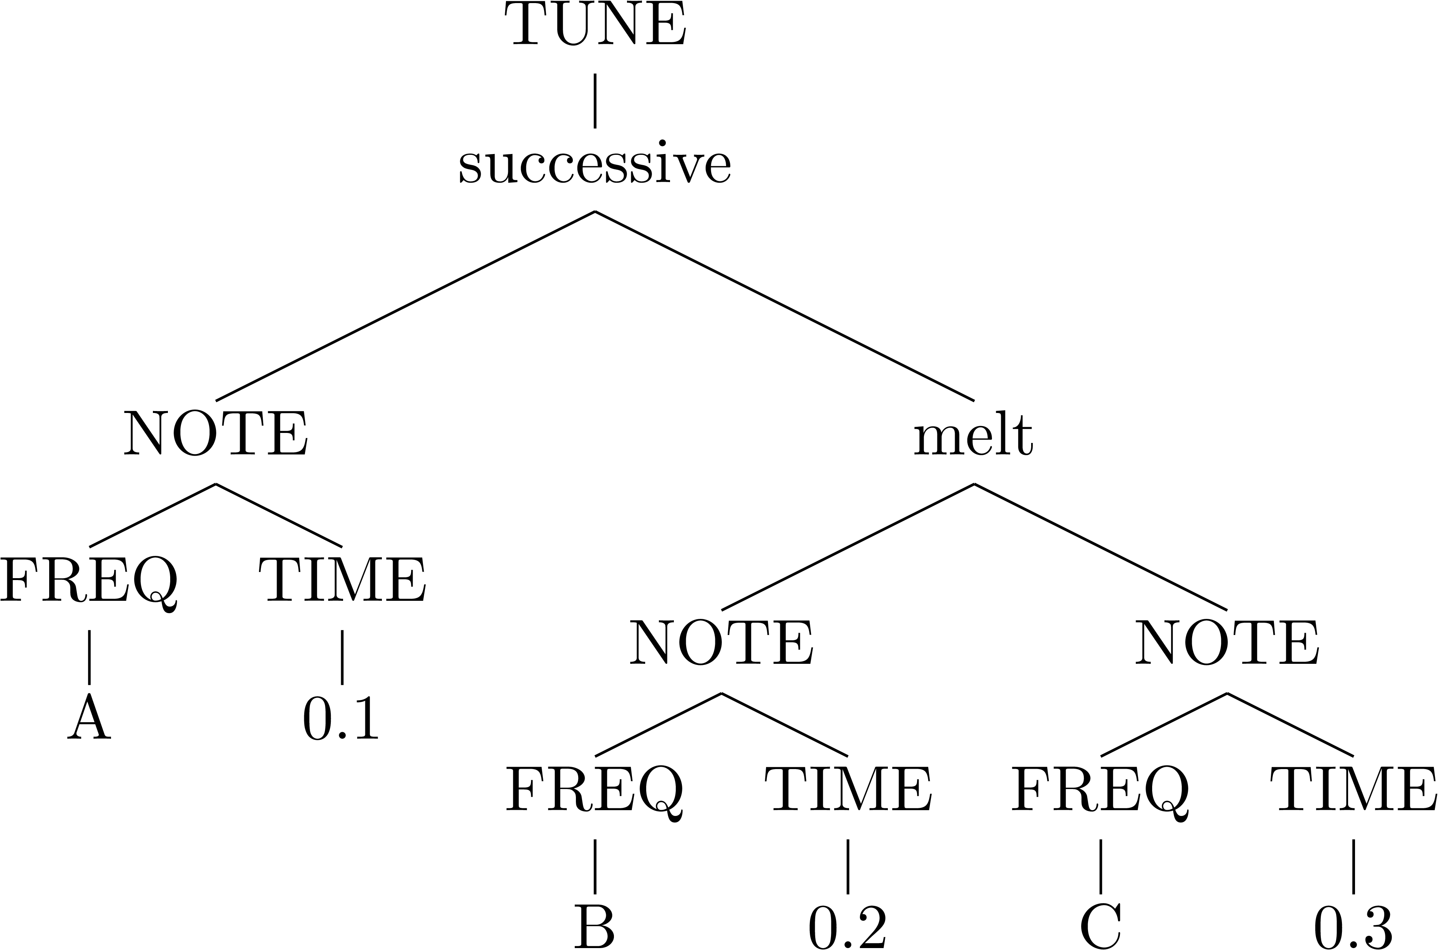
Sound grammar
(For the sake of our ears, let’s only keep A, C, D, E, G)

Slide 16
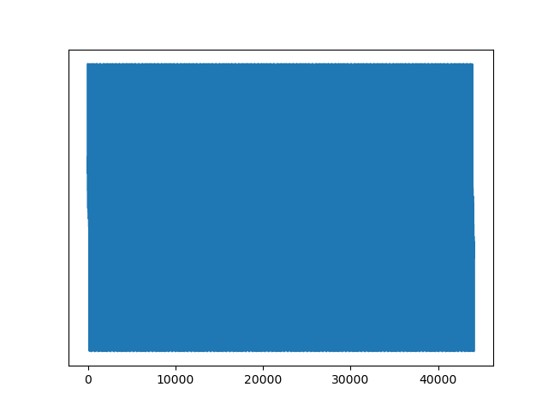
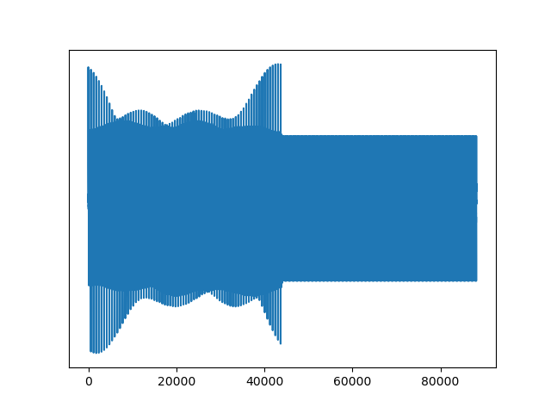


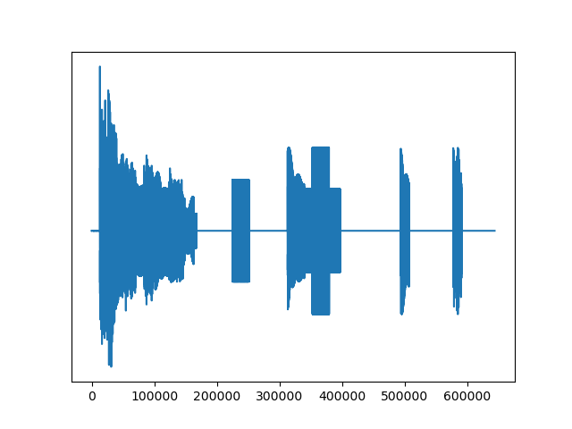
Sound semantics

Slide 17
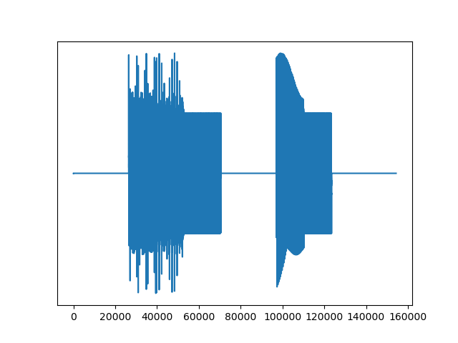
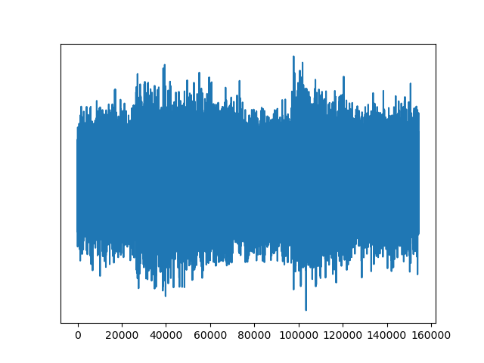
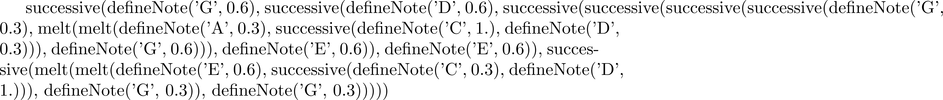
Audio observations

Slide 18
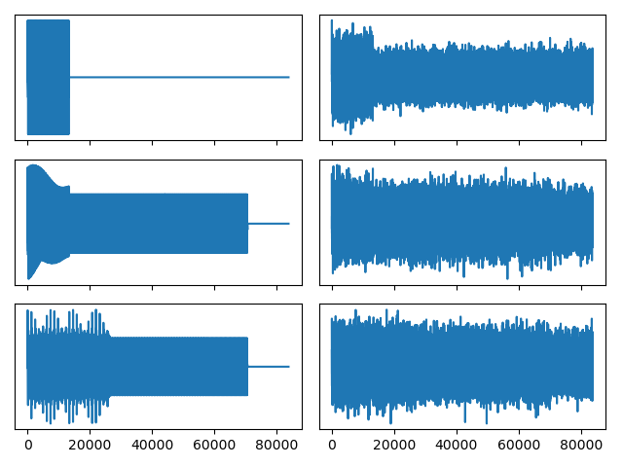


Priors and likelihoods

Slide 19
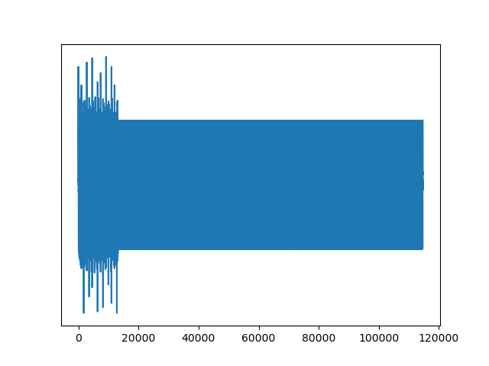
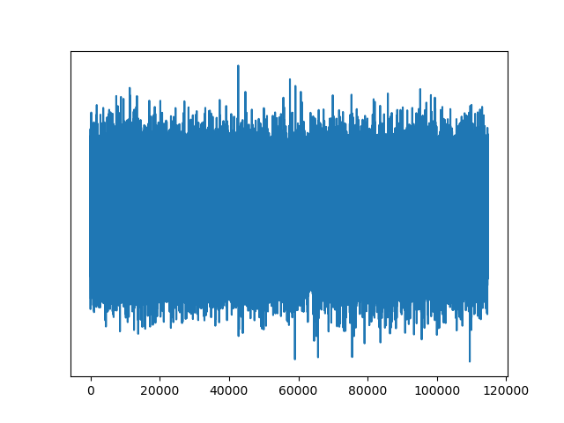
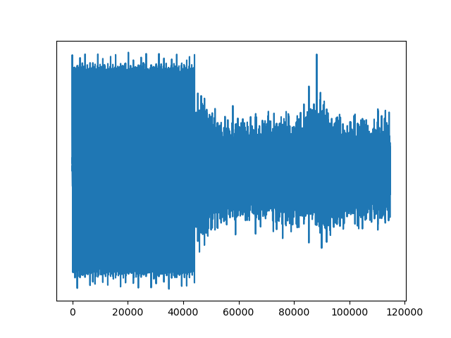
Learning: Bayesian inference in a PCFG
MAP
Posterior mean

Slide 20
LoT learning models: the big picture
Interpreted PCFG
Defines hypotheses H
Defines a prior over H
Observations O
Generated by true H
Likelihood P(O | H)
Bayesian inference
Approximate!
Sound grammar
Each H is a sentence…
…which encodes a sound
Sound (with noise)
Multiple H produce same sound!
Likelihood P(audio | sound)
MCMC w/ e.g., LOTlib3
Gives us samples from posterior!

Slide 21
Summary: Building a pLoT model
Pick a domain, e.g., music, geometry, logical concepts
Write a (plausible) list of primitive concepts
Write a PCFG
Define a likelihood function
Produce an observation
Sample from the PCFG
Hand-design
Use naturally occurring
Run inference algorithm

Slide 22
Interim remarks

Slide 23
Important features
Simpler representations have a higher prior
Simpler <--> More probable in the pLoT (PCFG)
Three ways probabilities enter the picture
Likelihood function
Prior given by PCFG
Stochastic primitives

Slide 24
Important features
What we have been doing is essentially program induction
Define a simple programming language
Find (a distribution over) programs that produce some output given some input
In domains above, pLoT sentences denoted single objects
…but each sentence in the pLoT can denote a function
Observations are (inputs, output) tuples
Categories (sets) are a special case with Boolean output
Observations can be e.g., samples from the category
Size effect!

Slide 25

Some hypotheses types
Input | Output | Stochastic primitives | Meaning | Example
 | Domain object | No | Single domain object | Shape
 |  | Yes | Graded category | Cup
Domain object | Boolean | No | Category | Primes
 |  | Yes | Graded category
Domain object | Domain object | No | Transformation | Adding 3
 |  | Yes | Stochastic transf | Jumping
… | … | … | …

Slide 26
Example 3: Binary strings

Slide 27
Let’s build it together!
Write a PCFG
Write an interpretation function
Construct an example of data
Run the inference

Slide 28
Conclusions
We saw how to construct a model of category learning w/ a pLoT
Two example domains:
Shapes
Sounds
Many more to be explored!
Next step: Literature using this kind of model.
Part I | Introduction: On the very idea of an LoT
Part II | Technical background
Part III | Bayesian program induction (LOTlib3)
Part IV | Case studies
Part V | Summary & Future prospects

